Slide 1
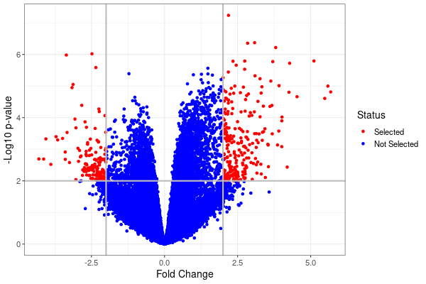
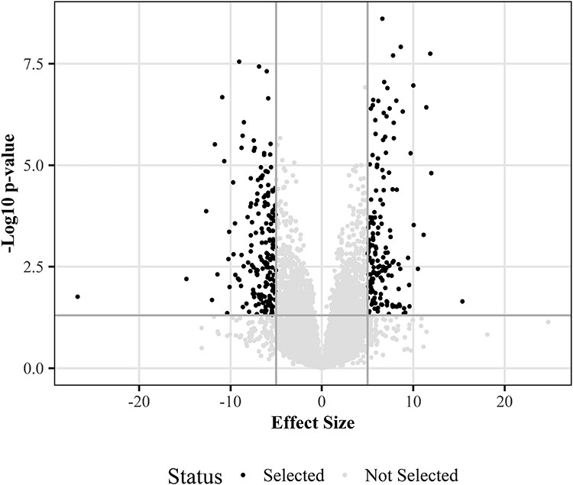
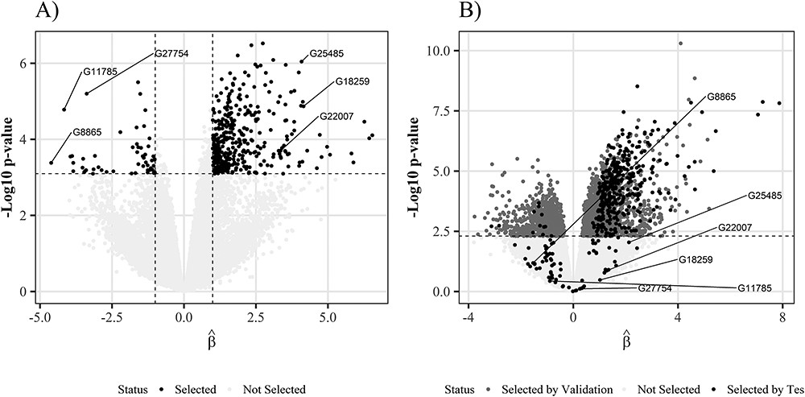

Controle du FDR dans les graphiques en Volcan pour données Omiques
Célia Vidal & Vivien Dupont Data Science en santé et biostatistiques, Ensai
Introduction
Objectifs
Recommandations
FIGURE 1: Volcano plot
FIGURE 2: Volcano plot 2
◀
◀
Méthodes
Résutltas
Briefly describe the stimuli and methods. Use pictures instead of words where possible.
When you change the section header, resize the text box so that the amount of white space on either side of the header is consistent with the other headers. Place the header in the center of the top line.
You can use the navy, coral, and gray colors to represent different conditions.
font family: Avenir
color scheme:
navy
coral
gray
#1E4E79
#F5584E
#BBCACD
Résumé
◀
FIGURE 4 : Volcano plot 3
Référence
Ebrahimpoor (2021) Inflated false discovery rate due to volcano plots: problem and solutions
name@university.edu

